Slide 1
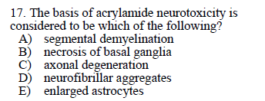

Slide 2
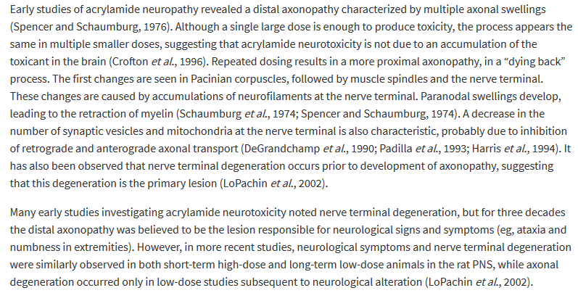
Answer: C ??
Chapter 16, p. 746

Slide 3
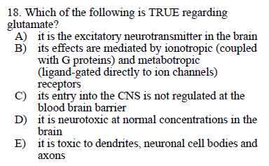

Slide 4
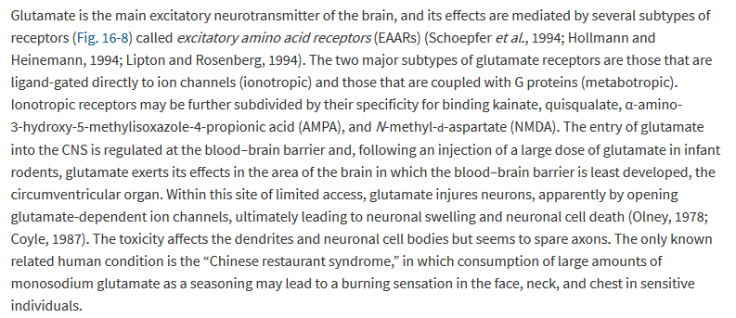
Answer: A
Chapter 16, p. 753

Slide 5
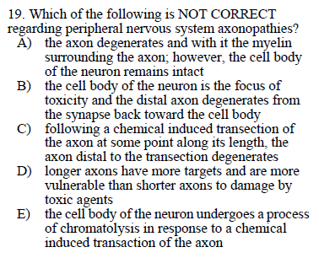

Slide 6
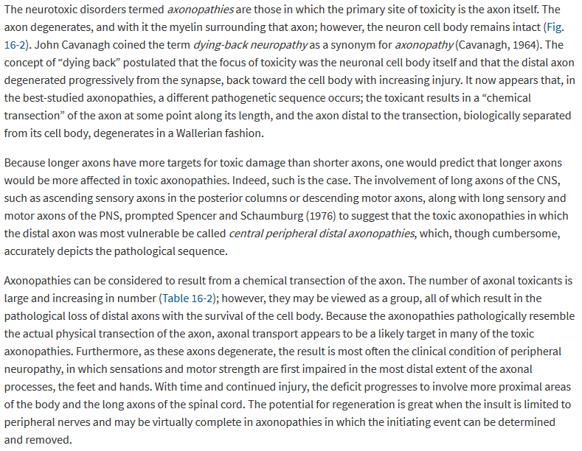

Answer: B
Chapter 16, p. 742

Slide 7
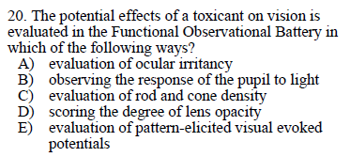

Slide 8
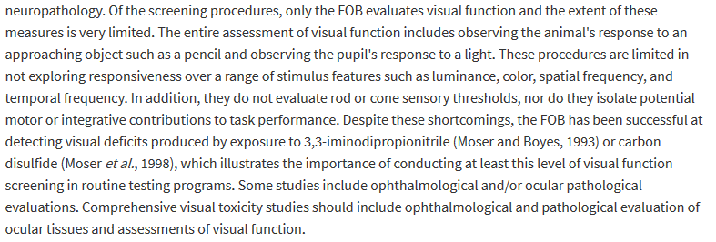
Answer: B
Chapter 17, p. 776-777

Slide 9
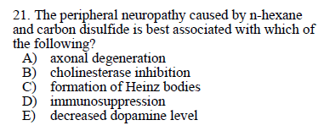

Slide 10
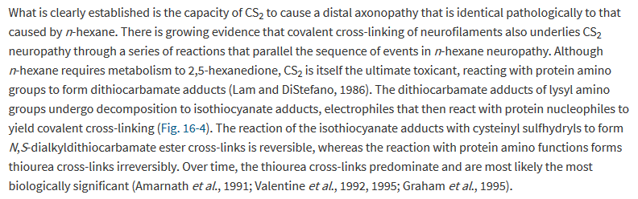
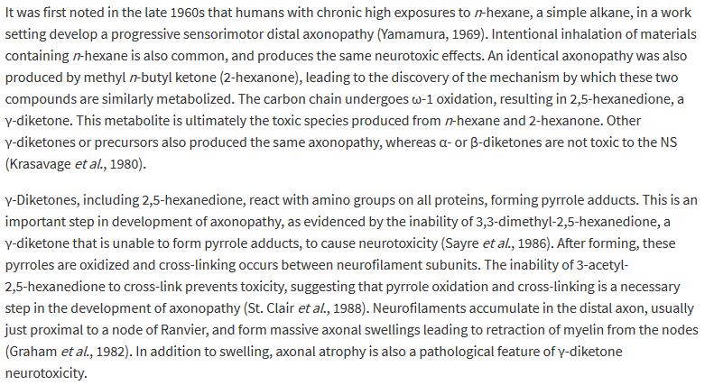
Answer: A
Chapter 16, p. 744

Slide 11
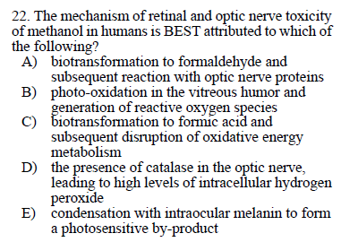

Slide 12
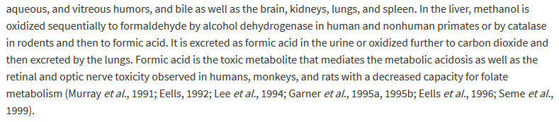
Answer: C
Chapter 17, p. 785

Slide 13
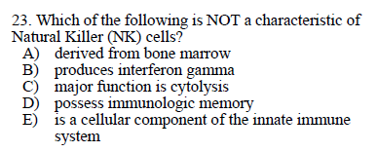

Slide 14
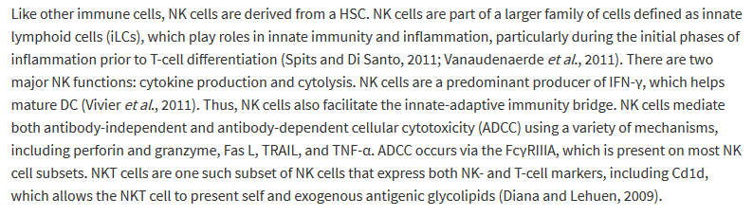
Answer: D
Chapter 12, p. 567

Slide 15
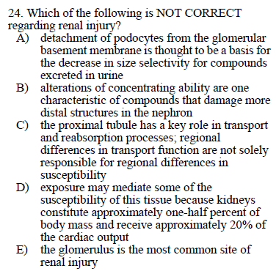

Slide 16

√
√
√
√
A
B
C
Answer: E
D
E
Chapter 14, p. 674

